Slide 1
steps for making a plastic face shield from a 2L bottle and cap
please share this collaborative
design from 1955 in Kliptown

Slide 2
THE PLASTIC FACE SHIELD DOES NOT STOP THE TRANSMISSION OF COVID-19, IT GIVES SOME LEVEL OF PROTECTION TO THE WEARER WHEN PHYSICAL DISTANCING IS NOT POSSIBLE.
It stops you from touching your own eyes, nose, mouth
It stops large airborne droplets which can carry the virus

Slide 3
A cotton face mask can also be worn tightly against the face under the shield to help prevent transmitting the virus to others.
If used, cotton face mask MUST be washed with hot water and detergent daily.

Slide 4
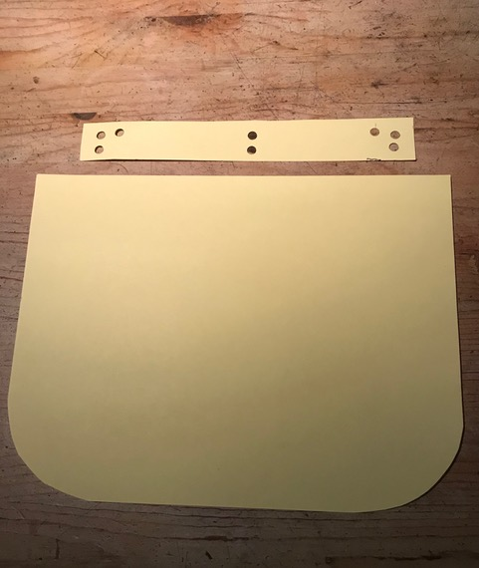
The basic pattern
6cm difference
forehead strip
shield

Slide 5
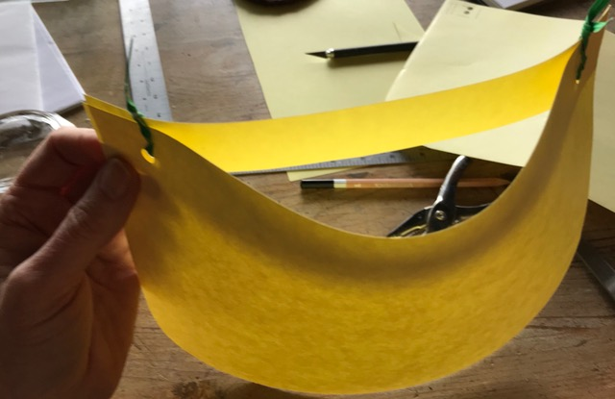
Assembling the shield
Creating
the air vent
forehead strip
shield

Slide 6
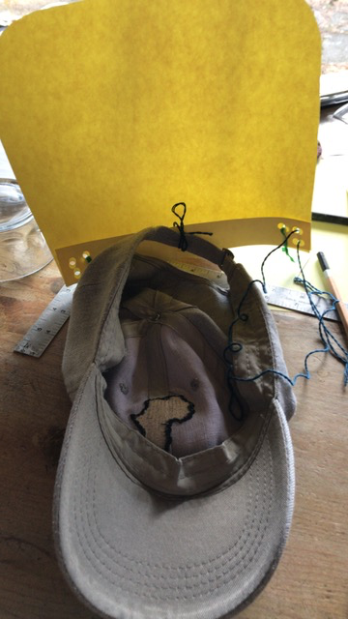
Attaching the shield to the cap
Sew the shield
to the outside
of the cap

Slide 7
The face shield

Slide 8
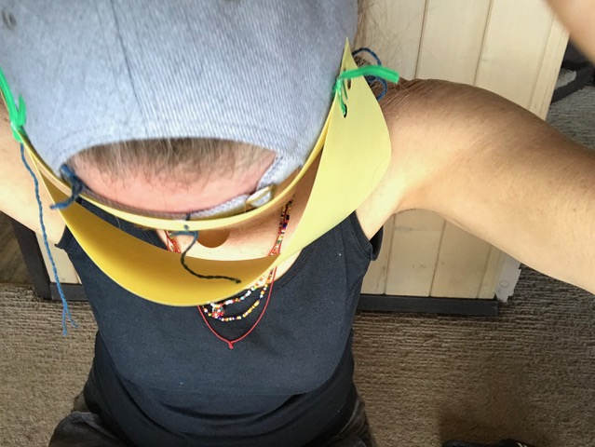
The air vent
Increases comfort
and reduces fogging

Slide 9
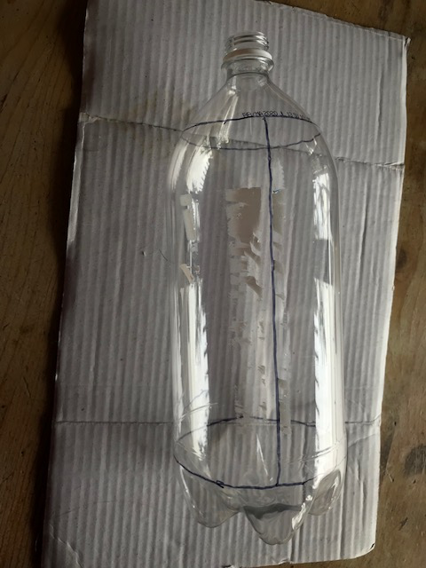
Cutting the
2L plastic bottle
The bottle
has 3 cuts
1
3
2

Slide 10
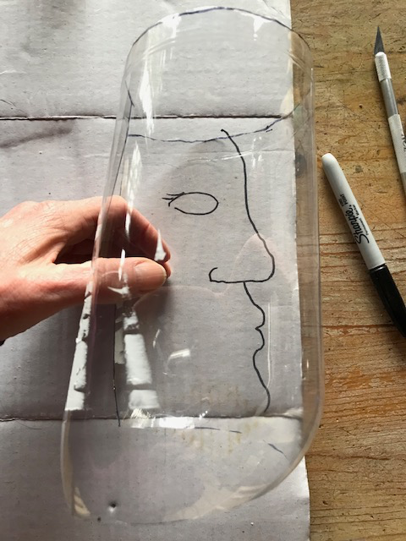
2L bottle as shield
The bottom
of the bottle
becomes
the top of the
face shield

Slide 11
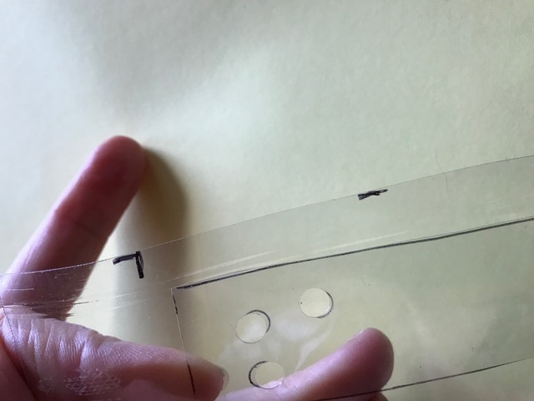
Forehead strip + shield
Align the forehead strip 3cm
from the top outer edge
on the inside of the shield.

Slide 12
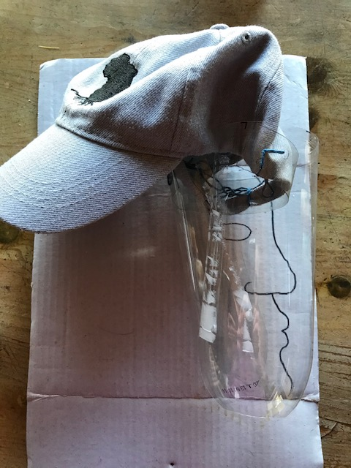
Sewing the
shield + cap
Stitch shield to
outside of cap
Smooth & round
all plastic edges

Slide 13
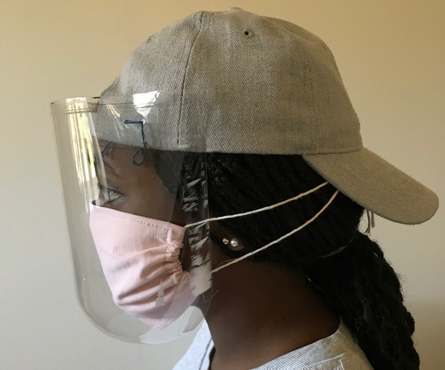
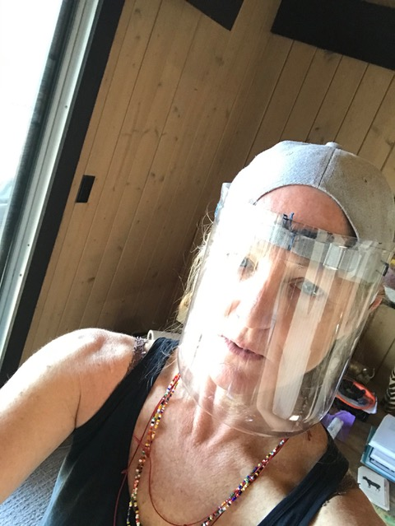
The face shield

Slide 14
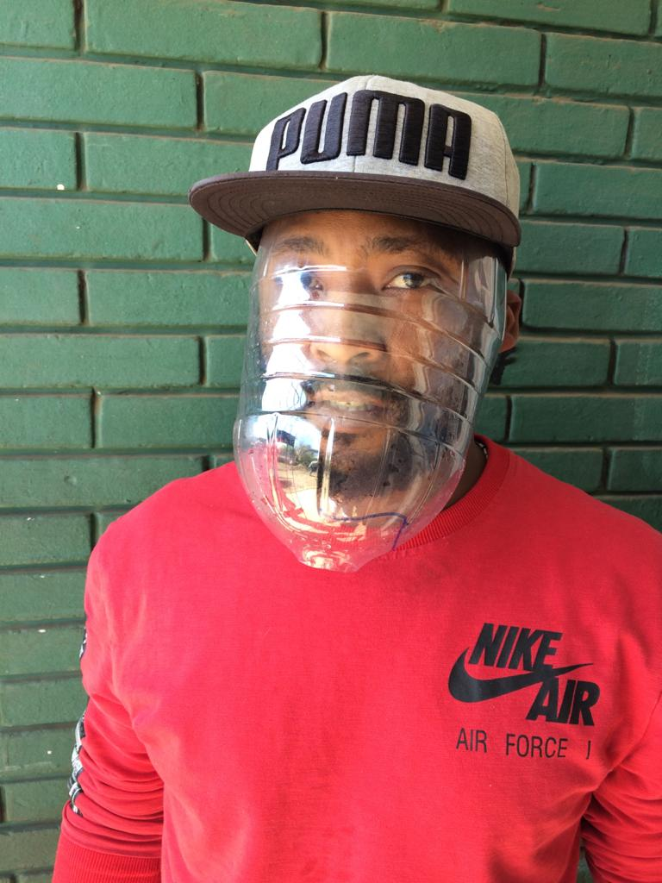
The face shield
without an air vent

Slide 15
Plastic Face Shield
care & use
ONLY USE YOUR OWN FACE SHIELD, don’t share your shield!
The plastic should fully cover your face.
The shield should not touch your mouth.
Wash your hands after removing the shield.
Wash the shield daily with soap and water, air dry.
(guidelines from WHO and medical doctor/public health expert)

Slide 16
Cotton Face Mask
care & use
The mask should fit tightly agains your face.
Avoid touching the mask when on your face.
USE ONLY YOUR OWN FACE MASK.
Remove the mask from the straps, don’t touch the front of the mask.
Wash your hands after removing a used mask.
Wash the mask daily with detergent and water.
Use of cotton face mask is safer with face shield.
Make a cloth face mask (CDC, 2020)
Use a cloth face mask (WHO, April 2020)
(guidelines from WHO and CDC)

Slide 17
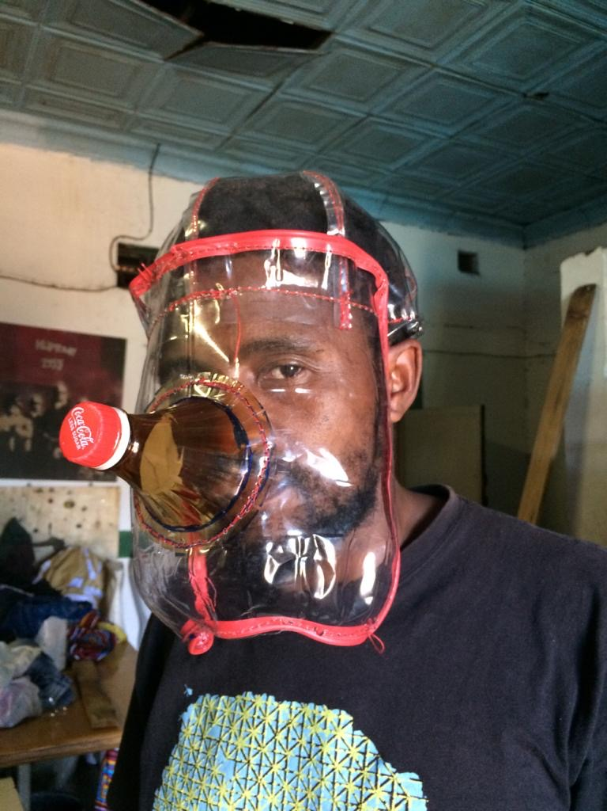
WASH YOUR HANDS OFTEN
All face shields shown are our evolving designs for protection + comfort.
From Kliptown,
Sala kahle!

